Slide 1
Fashion Retail Analysis
Group Name: DVG Analytics
Group members:
1. Dennis Kirimi
2. Victor Mwenda
3. Gerald Mayanja

Slide 2
Problem Statement & Objectives
This project aims to analyse sales data for a fashion retail business to uncover actionable insights about products, customers, time-based trends, and inventory management. The goal is to help the business improve decision-making and maximize profitability.
Understand customer behavior, sales patterns, and inventory dynamics.

Slide 3
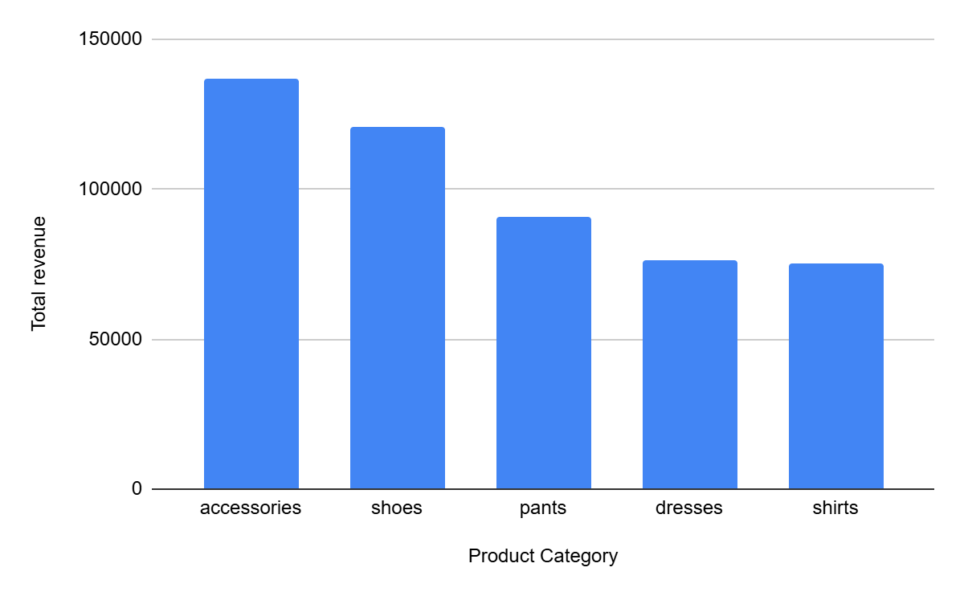
Top 5 Selling Products
Product categories such as accessories and shoes generated the most revenue.
Recommendation:
Prioritize Inventory for High-Demand Categories- Ensure accessories and shoes are always well-stocked to avoid missed sales opportunities, especially during high-traffic seasons.

Slide 4
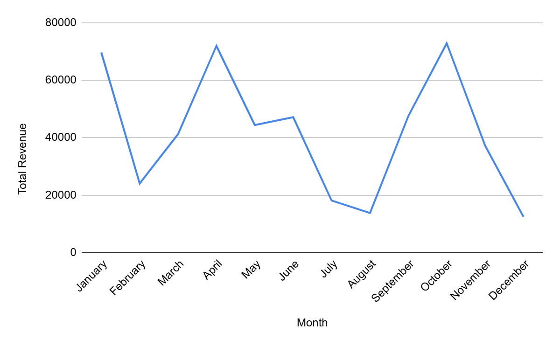
Monthly Sales Trend
January , April, and October yielded higher sales volume i.e above 60,000 total revenue while July, august and December yielded the lowest sales volume i.e below 20,000 total revenue
Recommendation:
Plan major product launches and promotions/ discounts around January, April, and October to maximize revenue.

Slide 5
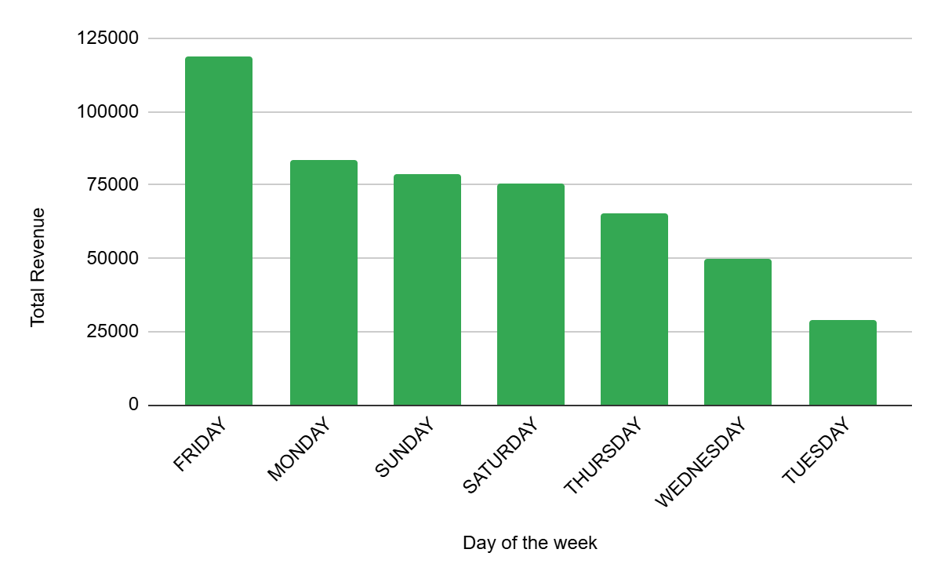
Weekly Analysis
Friday had the highest revenue of 118733.37.
Recommendation:
Focus marketing campaigns, promotions, and new product launches on Fridays to capitalize on high customer activity.

Slide 6
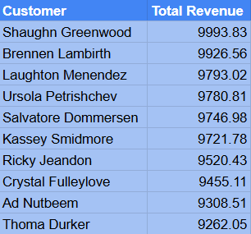
Customer Insights
Top Ten performing customers are shown in the table.
All customers are repeated i.e no new customers so far.
Brightbean has the most active buyers compared to other locations.

Slide 7
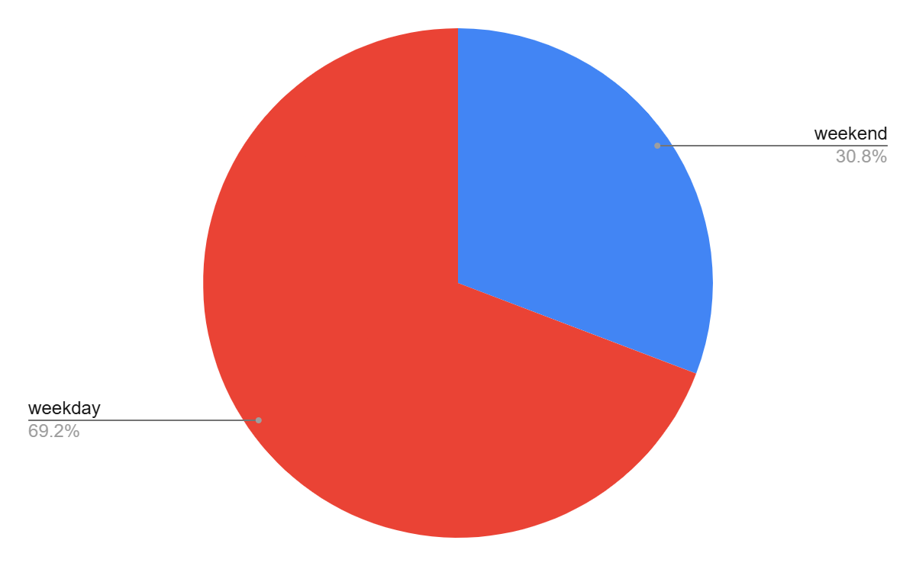
Time-Based Analysis
1. The sales during the weekdays(69.2%) far exceeded the sales during the weekend(30.8%).
2. We were supposed to find the
peak shopping hours(if timestamp
was available) but the was no
column that indicated time.

Slide 8
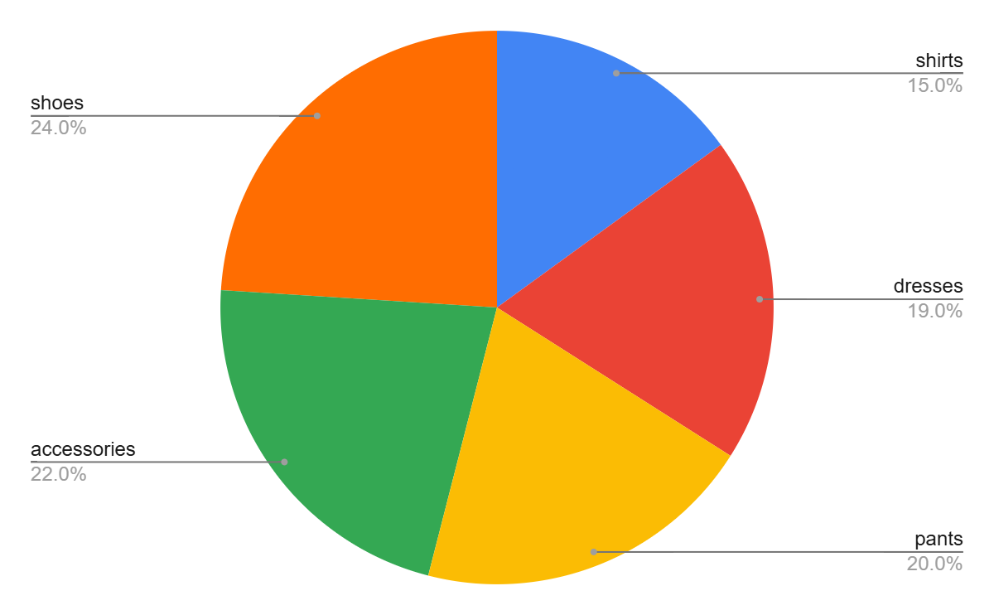
Inventory Insights
1. The low stock items were; shirts(15%), dresses(19%), pants(20%), assessories(22%) and shoes(24%) in that order.
2. Shoes were the items that were ordered more thus the ones that were frequently restocked.

Slide 9
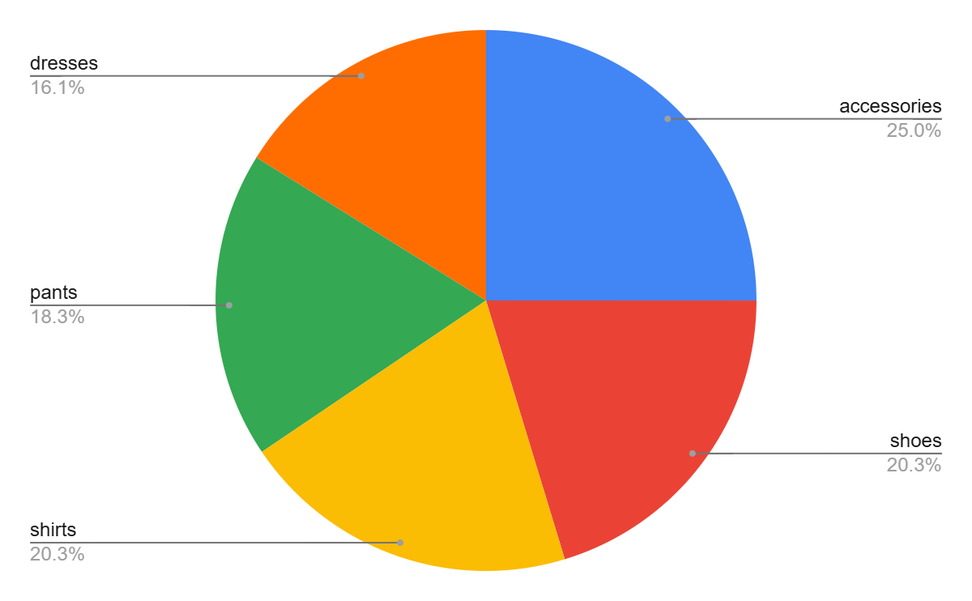
Custom question
The average revenue for each category was as follows;
Accessories - 6212.08
Shoes -5031.76
Pants -4551.23
Dresses – 4009.62
Category | Revenue
accessories | 6212.08
shoes | 5042.33
shirts | 5031.76
pants | 4551.23
dresses | 4009.62

Slide 10
Summary (Recap major insights)
Product categories such as accessories and shoes generated the most revenue.
January , April, and October yielded higher sales volume while July, august and December yielded the lowest sales volume
Friday is the best the day
Top Ten performing customers are shown in the table.
All customers are repeated i.e no new customers so far.
Brightbean has the most active buyers compared to other locations.

Slide 11
Business Recommendations
1. Focus on Best-Selling Categories
Expand stock and marketing for accessories and shoes.
2. Boost Sales in Low-Performing Months
Run promotions in July, August, and December.
3. Leverage High Sales on Fridays
Introduce Friday flash sales or weekend kick-off offers.
4. Strengthen Customer Loyalty
Launch a loyalty or rewards program for repeat buyers.
5. Replicate Brightbean’s Success
Analyze and apply Brightbean’s strategies to other outlets.
6. Attract New Customers
Implement referral programs and digital marketing to grow the customer base.

